Slide 1
Sequential pattern mining
Sequential pattern mining is a topic of data mining concerned with finding statistically relevant patterns between data examples where the values are delivered in a sequence.

Slide 2
Sequence Database
A sequence database consists of sequences of ordered elements or events, recorded with or without a concrete notion of time.
There are many applications involving sequence data.
Typical examples include customer shopping sequences, Web click streams, biological sequences, sequences of events in science and engineering, and in natural and social developments.

Slide 3
What is sequential pattern mining?
Sequential pattern mining is the mining of frequently occurring ordered events or subsequences as patterns.
An example of a sequential pattern is “Customers who buy a Canon digital camera are likely to buy an HP color printer within a month.”
For retail data, sequential patterns are useful for shelf placement and promotions.
This industry, as well as telecommunications and other businesses, may also use sequential patterns for targeted marketing, customer retention, and many other tasks.
Other areas in which sequential patterns can be applied include Web access pattern analysis, weather prediction, production processes, and network intrusion detection.

Slide 4
Sequence:
A sequence is an ordered list of events.
A sequence s is denoted {e1, e, 2e3, . . . el}, where event e1 occurs before e2, which occurs before e3, and so on.
Event e j is also called an element of s.
In the case of customer purchase data, an event refers to a shopping trip in which a customer bought items at a certain store.
The event is thus an itemset, that is, an unordered list of items that the customer purchased during the trip.
The itemset (or event) is denoted (x1x2. . . . .xq), where xk is an item.

Slide 5
Sequences are a very common type of data structures that can be found in many domains such as bioinformatics (DNA sequence), sequences of clicks on websites, the behavior of learners in e-learning, sequences of what customers buy in retail stores, sentences of words in a text, etc.
It is to be noted that sequence can be ordered by time or other properties (e.g. the order of nucleotides in a DNA sequence).

Slide 6
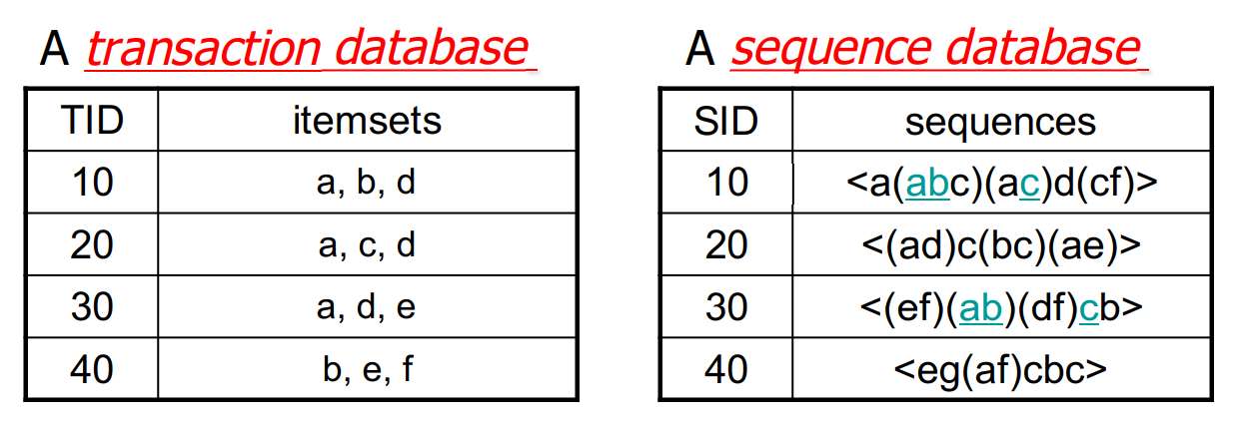
Sequence Databases:
A sequence database consists of ordered elements or events.
Transaction databases vs. sequence databases

Slide 7
Pattern mining:
Pattern mining consists of discovering interesting, useful, and unexpected patterns in databases.
Various types of patterns can be discovered in databases such as frequent itemsets, associations, subgraphs, sequential rules, and periodic patterns.
The goal of pattern mining is to discover useful, novel and/or unexpected patterns in databases.

Slide 8
Sequential pattern mining:
The task of sequential pattern mining is a data mining task specialized for analyzing sequential data, to discover sequential patterns.
More precisely, it consists of discovering interesting subsequences in a set of sequences, where the interestingness of a subsequence can be measured in terms of various criteria such as its occurrence frequency, length, and profit.
Sequential pattern mining has numerous real-life applications due to the fact that data is naturally encoded as sequences of symbols in many fields such as bioinformatics, e-learning, market basket analysis, texts, and webpage click-stream analysis

Slide 9
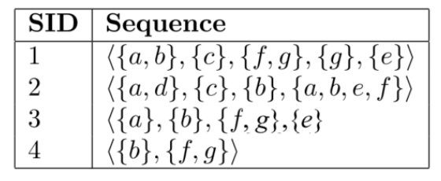
Example: Consider the following sequence database, representing the purchases made by customers in a retail store.

Slide 10
This database contains four sequences.
Each sequence represents the items purchased by a customer at different times. A sequence is an ordered list of itemsets (sets of items bought together).
For example, in this database, the first sequence (SID 1) indicates that a customer bought some items a and b together, then purchased an item c, then purchased items f and g together, then purchased an item g, and then finally purchased an item e.

Slide 11
Frequent sequential patterns:
Traditionally, sequential pattern mining is being used to find subsequences that appear often in a sequence database, i.e. that are common to several sequences.
Those subsequences are called the frequent sequential patterns.
For example, sequential pattern mining can be used to find the sequences of items frequently bought by customers.
This can be useful to understand the behavior of customers to take marketing decisions.

Slide 12
Minimum support threshold:
To do sequential pattern mining, a user must provide a sequence database and specify a parameter called the minimum support threshold.
This parameter indicates a minimum number of sequences in which a pattern must appear to be considered frequent, and be shown to the user.
For example, if a user sets the minimum support threshold to 2 sequences, the task of sequential pattern mining consists of finding all subsequences appearing in at least 2 sequences of the input database.

Slide 13
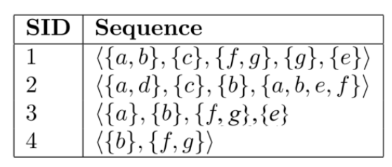
In the example database, 29 subsequences met this requirement.
These sequential patterns are shown in the table below, where the number of sequences containing each pattern (called the support) is indicated in the right column of the table.

Slide 14
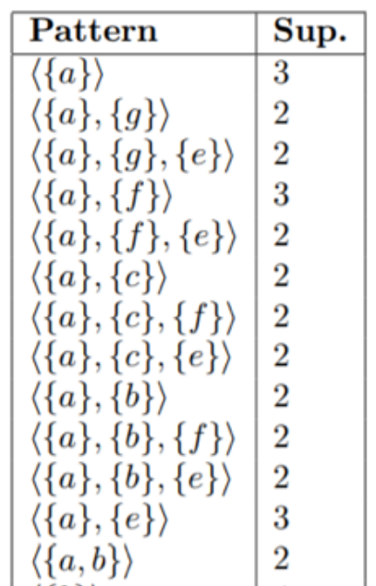
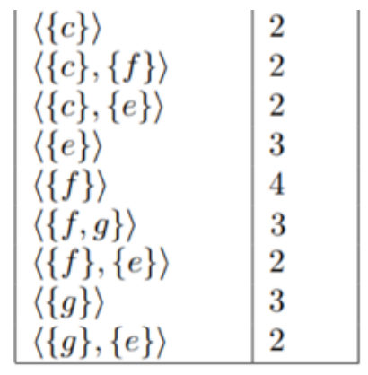
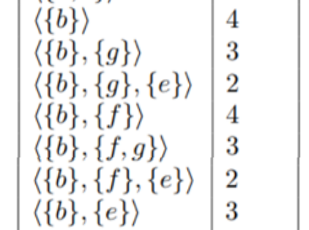

Slide 15
For example, the patterns <{a}> and <{a}, {g}> are frequent and have a support of 3 and 2 sequences, respectively.
In other words, these patterns appears in 3 and 2 sequences of the input database, respectively.
The pattern <{a}> appears in the sequences 1, 2 and 3, while the pattern <{a}, {g}> appears in sequences 1 and 3.
These patterns are interesting as they represent some behavior common to several customers.

Slide 16
A sequential pattern is a subsequence that appear in several sequences of a database.
For example, the sequential pattern <{a}{c}{e}> appears in the two first sequences of the database.
It indicates that customers who bought {a}, often bought {c} after, followed by buying {e}.
Such a pattern is said to have a support of two sequences because it appears in two sequences from the database.

Slide 17
Algorithms
Several algorithms have been proposed for finding all sequential patterns in a database such as
1. CM-SPADE,
2. PrefixSpan and
3. GSP.
These algorithms takes as input a sequence database and a minimum support threshold (minsup).
Then, they will output all sequential patterns having a support no less than minsup.
Those patterns are said to be the frequent sequential patterns.

Slide 18
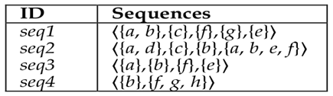
Example:

Slide 19
Example:
Run CM-SPADE with minsup = 3,
will find the following frequent sequential patterns:
<{a}> with a support of 3 sequences
<{a},{e}> with a support of 3 sequences
<{a},{f}> with a support of 3 sequences
<{b},{e}> with a support of 3 sequences
<{b},{f}> with a support of 4 sequences

Slide 20
Sequential rule mining has been proposed as an alternative to sequential pattern mining to take into account the probability that a pattern will be followed.
A sequential rule is a rule of the form X -> Y where X and Y are sets of items (itemsets).
A rule X ->Y is interpreted as if items in X occurs (in any order), then it will be followed by the items in Y (in any order).
For example, consider the rule {a} -> {e,f}.
It means that if a customer buy item “a”, then the customer will later buy the items “e” and “f”.
But the order among items in {e,f} is not important.
This means that a customer may buy “e” before “f” or “f” before “e”.

Slide 21
To find sequential rules, two measures are generally used:
The support and the confidence.
The support of a rule X -> Y is how many sequences contains the items from X followed by the items from Y.
For example, the support of the rule {a} -> {e,f} is 3 sequences because {a} appears before the items from {e,f} in three sequences (seq1, seq2 and seq3).

Slide 22
The confidence of a rule X -> Y is the support of the rule divided by the number of sequences containing the items from X.
It can be understood as the conditional probability P(Y|X).
For example, the confidence of the rule {a} -> {e,f} is 1 (or 100 % if written as a percentage), because every time that a customer buy item “a”, he then buy “e” and “f” in the example database.
Another example is the rule {a} -> {b}.
This rule has a support of 2 sequences and a confidence of 0.66 (that is 66%).

Slide 23
A sequential rule mining algorithm such as RuleGrowth, ERMiner and CMRules will output all sequential rules having a support and a confidence respectively no less than some thresholds minsup and minconf set by the user.
For example, consider again the example database and suppose that the user set minsup = 0.5 and minconf = 60%. The following rules are found by RuleGrowth:

Slide 24
{a,b,c} -> {e} support = 2 sequences confidence = 100 %
{a} -> {c,e,f} support = 2 sequences confidence = 66%
{a,b} -> {e,f} support = 3 sequences confidence = 100%
{b} -> {e,f} support = 3 sequences confidence = 75 %
{a} -> {e,f} support = 3 sequences confidence = 100%
{c} -> {e,f} support = 2 sequences confidence = 100%
{a} -> {b} support = 2 sequences confidence = 66%

Slide 25
Applications of sequential rule mining:
1. E-learning
2. Manufacturing simulation
3. Quality control
4. Web page prefetching
5. Anti-pattern detection in service based systems,
6. Embedded systems
7. Alarm sequence analysis

